Slide 1
An English man in New York
Capstone Project: The Battle of Neighborhoods.

Slide 2
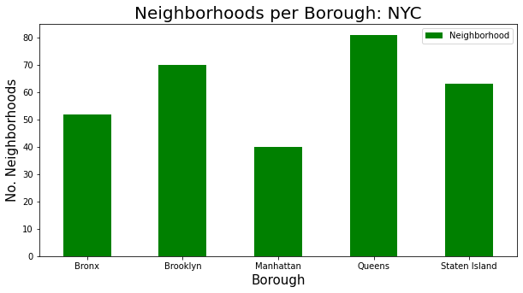
Get initial New York data
Get data from https://cocl.us/new_york_dataset
Perform initial data analysis
Show Neigborhoods per Borough
Neighborhoods in New York are located within five boroughs. Bronx, Brooklyn, Manhattan, Queens and Staten Island.

Slide 3
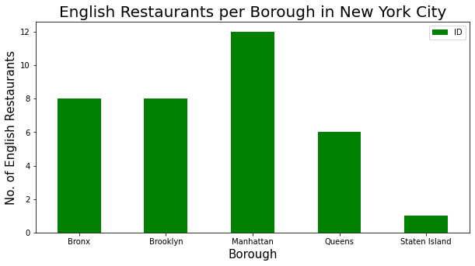
Discover the locale of English Restaurants by borough
Use a ForeSquare API call and categories 'English Restaurant', 'Pub', and 'Fish & Chips Shop' to determine all potential English Restaurants.
Show the number of English Restaurants per borough

Slide 4
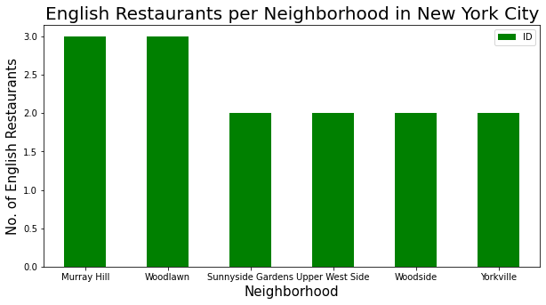
Discover the locale of English Restaurants by neighborhood
Show the number of English Restaurants per neighborhood

Slide 5
Process likes, ratings and tips data
Discover the ratings of said English Restaurants
Discover which English Restaurants have the greatest number of Likes, Ratings, Tips
Discover the neighborhoods with the best average ratings of restaurants
Discover the boroughs with the best average ratings of restaurants
Discover all the neighborhoods with average rating greater or equal 7.5 (upper quartile)

Slide 6
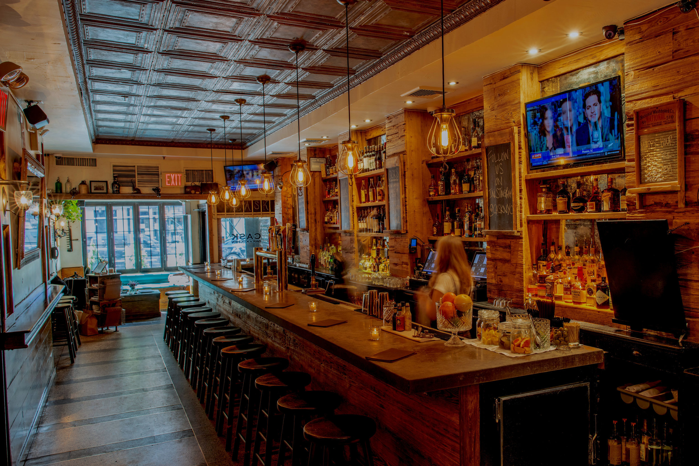
Cask Bar & Kitchen - New York City
The English Restaurant with the most likes, ratings and tips
Arguably the best place to go for a taste of England
Situated in the neighborhood of Murray Hill
Situated in the borough of Manhattan

Slide 7
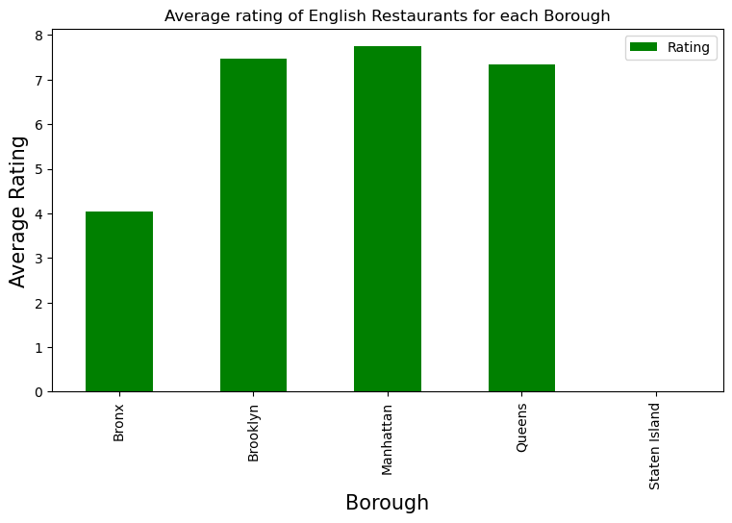
Discover the boroughs with the best average ratings of restaurants
The boroughs of Brooklyn, Manhattan and Queens all appear to have highly rated English Restaurants

Slide 8
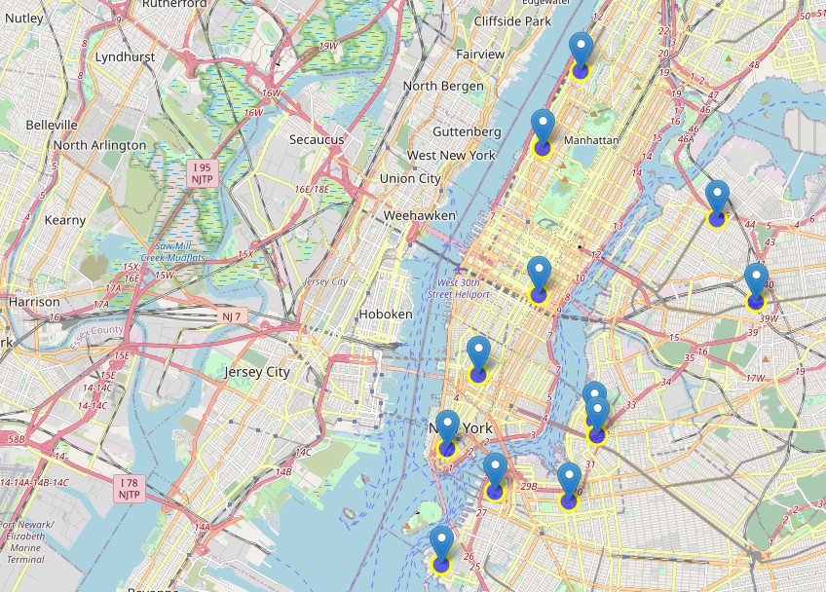
Discover all the neighborhoods with average rating greater or equal 7.5 (upper quartile)
Kingsbridge, Bronx(8.5)
Westchester Square, Bronx(7.8)
Edgewater Park, Bronx(7.8)
Morningside Heights, Manhattan(8.5)
Upper West Side, Manhattan(8.0)
Astoria, Queens(8.4)
Murray Hill, Queens(7.8)
Murray Hill, Manhattan(7.8)
Woodside, Queens(7.5)
Greenwich Village, Manhattan(8.6)
North Side, Brooklyn(8.0)
Financial District, Manhattan(8.1)
South Side, Brooklyn(7.7)
Brooklyn Heights, Brooklyn(7.6)
Clinton Hill, Brooklyn(8.6)
Red Hook, Brooklyn(7.6)

Slide 9
Conclusions
Highly rated English Restaurants appear to be fairly widely spread
There are not that may English Restaurands with a bad rating (some establishments have no ratings, perhaps because they are new).
The most popular English Restaurants appear to be located in Murray Hill, Manhatten. But could this just be based on location (tourist hot spots, etc).

